Slide 1
Deep Learning Basics

Slide 2










Content
01
What is Machine Learning?
02
Limitations of Machine Learning
03
What is Deep Learning?
04
Convolutional Neural Networks

Slide 3


Machine Learning

Slide 4
Types of Machine Learning
There are three types of machine learning algorithms:
Supervised learning: Data sets are labeled so that patterns can be detected and used to label new data sets
Unsupervised learning: Data sets aren't labeled and are sorted according to similarities or differences
Reinforcement learning: Data sets are not labeled but, after performing an action or several actions, the AI system is given feedback

Slide 5
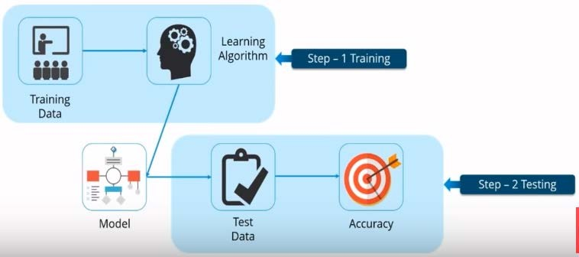
Supervised Learning
Supervised learning: Data sets are labeled so that patterns can be detected and used to label new data sets

Slide 6
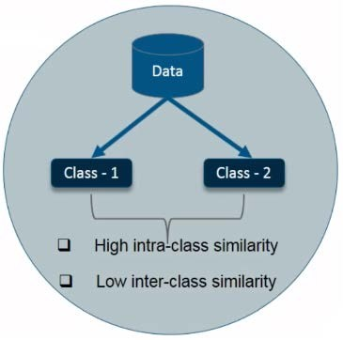
Unsupervised Learning
Data sets are not labeled and are sorted according to similarities or differences
No predefined classes
The unsupervised model can be used to cluster data
– clusters where a class has high intra-class similarity and low inter-class similarity
Example: grouping of customers based on priority

Slide 7
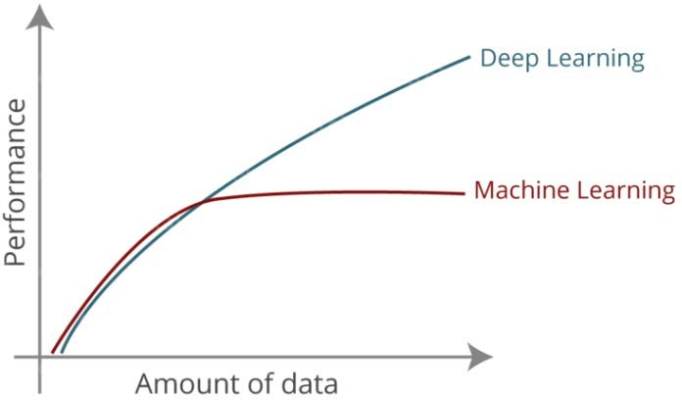
Limitations of the Machine Learning

Slide 8
Limitations of the Machine Learning
First Major Limitation – High Dimensional Data
High Dimensional Data: Traditional ML algorithms are not useful while working with high dimensional data, that is, where we have a large number of inputs and outputs.
For example, in case of handwriting recognition we have large amount of input where we will have different type of inputs associated with different type of handwriting.
Second Major Limitation – Feature Extraction
Feeding raw data to the ML algorithms rarely ever works
Feature extraction: to tell the computer what are the features it should look for that will play an important role in predicting the outcome as well as to achieve better accuracy while doing so.
Selection of good features becomes essential – object recognition, handwriting recognition, NLP etc.

Slide 9
Deep Learning

Slide 10
Deep Learning
No feature extraction required
Deep learning is one of the only methods by which we can overcome the challenges of feature extraction.
Deep networks are drawing inferences from data set consisting of input data without proper labeling.
Deep learning models are capable of learning to focus on the right features by themselves
Deep learning uses neural networks to simulate human like decision making
Deep learning models mimics the way our brain functions
That is, it learns from experience.

Slide 11
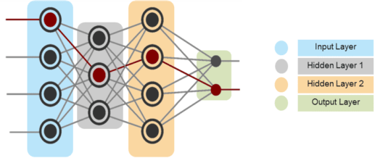
Deep Neural networks
Deep Neural networks can have multiple hidden layers
This was not possible in case of traditional neural networks

Slide 12
Neural Networks vs. Deep Learning (DNN)
“deep” in deep learning is just referring to the depth of layers in a neural network
Basic Neural Network
A neural network that only has two or three layers is just a basic neural network
Deep Neural Network
A neural network that consists of more than three layers—which would be inclusive of the inputs and the output—can be considered a deep learning algorithm

Slide 13
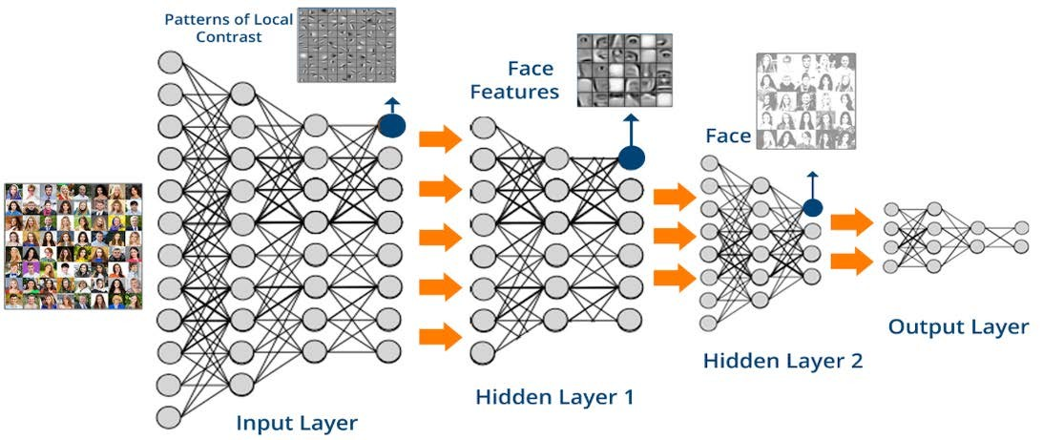
Face Recognition using Deep Networks
Face Recognition using Deep Networks

Slide 14
Face Recognition using Deep Networks
A deep neural network is capable of composing more and more complex features in each of its successive layers
At the lowest level, network fixates on patterns of local contrast
as important
The following layer is then able to use those patterns of local contrast to fixate on things that resemble eyes, noses, and mouths
Finally, the top layer is able to apply those facial features to face templates

Slide 15
CNN: Convolutional Neural Networks
A popular Deep Learning model
CNN has wide applications in
image recognition
video recognition
recommendation systems
natural language processing (NLP)
We will take up an example of image recognition to understand CNN

Slide 16
CNN: Convolutional Neural Networks
Why not fully connected networks?
What are CNNs?
Working of CNNs?
Case study: CIFAR10 Image Classifier

Slide 17
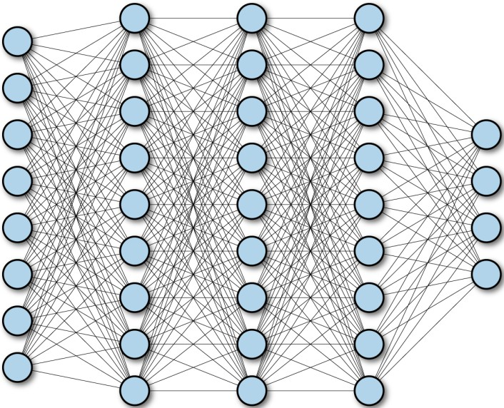
Fully Connected Networks
A fully connected neural network consists of a series of fully connected layers.
A fully connected layer is a function from ℝ_{m} to ℝ_{n}
A multilayer deep fully connected network.

Slide 18
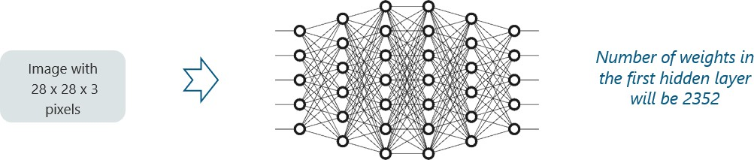
Why Not Fully Connected Networks?
For CNN, we cannot make use of fully connected networks
Reason: Let’s understand by an example
Input: an images of size 28 x 28 x 3 pixels
If we input this to CNN, we will have about 2352 weights in the first hidden layer itself
But is not practical

Slide 19

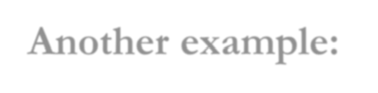
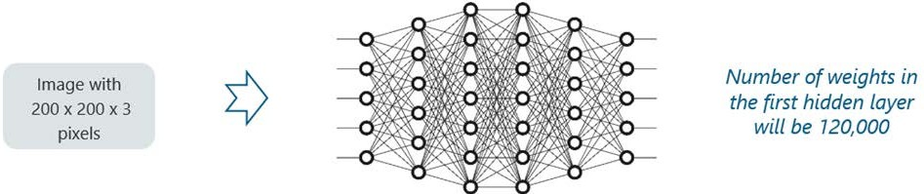
Why Not Fully Connected Networks?
Another example:
– input image of size 200x200x3 pixels (a very common input size).
– The size of the first hidden layer becomes a whooping 1,20,000.
If this is just the first hidden layer, imagine the number of neurons needed to process an entire complex image-set
This leads to over-fitting and isn’t practical.
Hence, we cannot make use of fully connected networks.

Slide 20
What are CNNs?
CNNs are similar to other neural networks
Neurons
learnable weights and
biases
Loss function for the network
Each neuron receives several inputs, takes a weighted sum over them, pass it through an activation function and responds with an output

Slide 21
How does a CNN Work?
Four layered concepts used in CNN:
Convolution
ReLU (Rectified Linear Unit)
Pooling and
Full Connectedness (Fully Connected Layer)

Slide 22
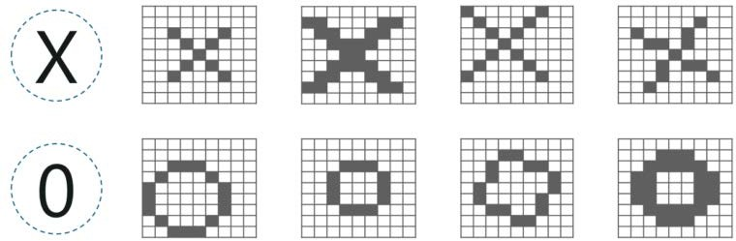
CNN - Example
Consider the images below:
there are multiple renditions of X and O’s
This makes it tricky for the computer to recognize

Slide 23
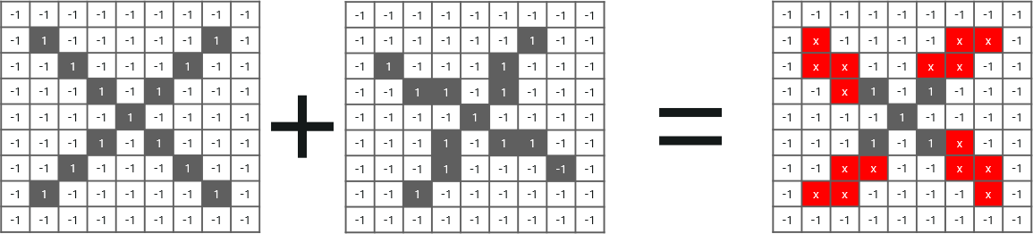
CNN - Example
If we compare a normal image and another ‘X’ rendition, we would get a lot of missing pixels
How do we fix this?

Slide 24
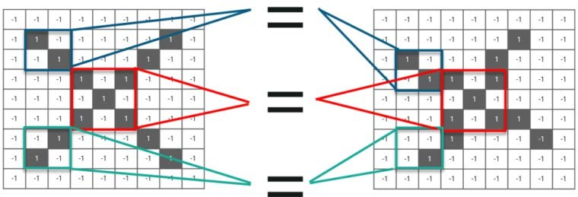
CNN – requirement of convolution
We take small patches of the pixels called filters and try to match them in the corresponding nearby locations to see if we get a match
By doing this, the Convolutional Neural Network gets a lot better at seeing similarity than directly trying to match the entire image

Slide 25
Convolution of an Image
Intuitively,
this means that each convolution filter represents a feature of interest (for example, pixels in letters), and
CNN algorithm learns which features comprise the resulting reference (i.e. alphabet)
Convolution has the nice property of being translational invariant.

Slide 26
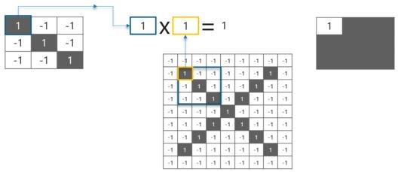
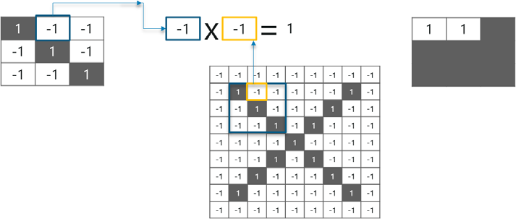
Convolution of an Image
We have 4 steps for convolution:
Line up the feature (filter) and the image
Multiply each image pixel by corresponding feature pixel
Add the values and find the sum
Divide the sum by the total number of pixels in the feature

Slide 27
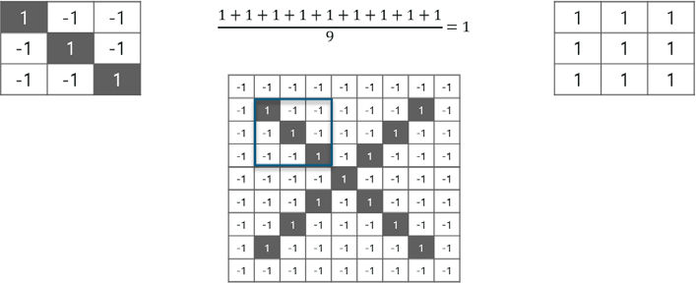
Convolution of an Image

Slide 28
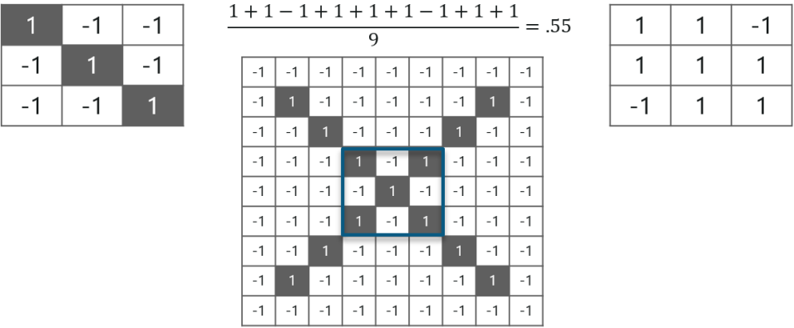
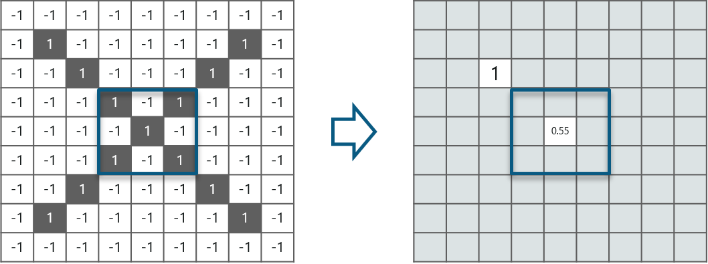
Convolution of an Image
We can move this filter around and do the same at any pixel in the image.
Example of convolution at different pixel below

Slide 29
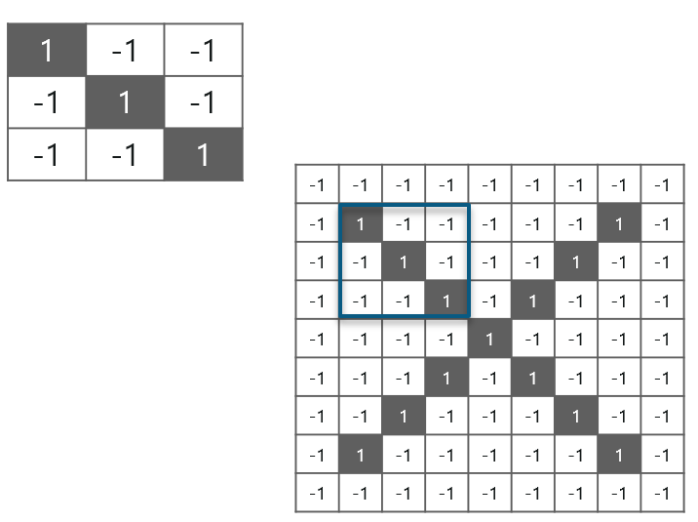
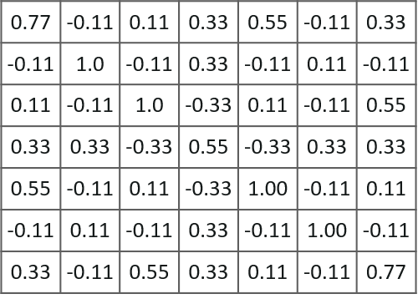
Convolution of an Image
Filter
Image after convolution
Image

Slide 30
CNN – ReLU Layer
Rectified Linear Unit (ReLU)
ReLU is an activation (transform) function
transform function only activates a node if the input is above a certain quantity
In ReLU:
when the input is below zero, the output is zero, and
when the input rises above a certain threshold, it has a linear relationship with the dependent variable

Slide 31
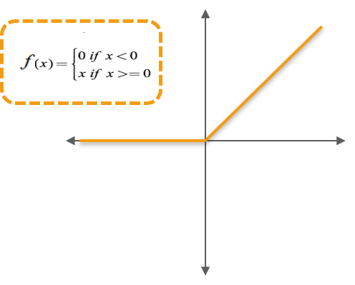
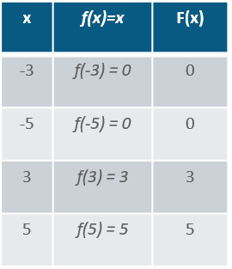
CNN – ReLU Layer: Example

Slide 32
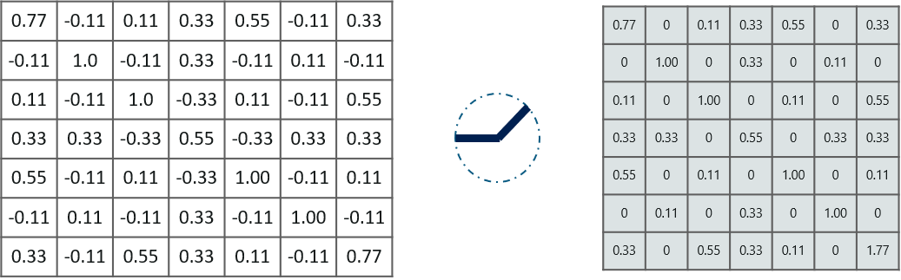
Why do we require ReLU here?
The main aim is
to remove all the negative values from the convolution
all the positive values remain the same but all the negative values get changed to zero

Slide 33
Why do we require ReLU here?
Introducing Non-Linearity:
CNNs process input data through layers of convolution and pooling, which are linear operations.
– Without an activation function, the model would behave as a linear transformation, limiting its ability to capture complex patterns.
– ReLU introduces non-linearity, enabling the network to learn and model more sophisticated relationships in data.
Sparse Activation:
ReLU activates only a subset of neurons at a time, as negative outputs are replaced with zero.
This sparsity makes the network more efficient and less prone to overfitting, as it reduces dependency on specific neurons.

Slide 34
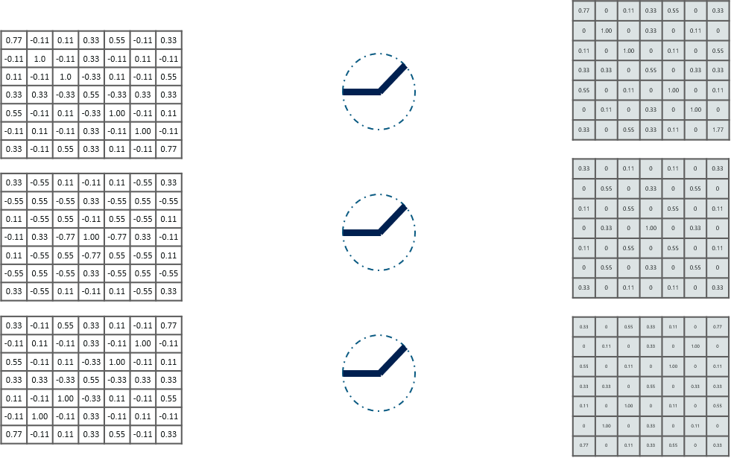
Why do we require ReLU here?
Now, similarly we do the same process to all the other feature images as well:
Filter-1 image
Filter-2 image
Filter-3 image

Slide 35
Pooling Layer
Inputs from the convolution layer can be “smoothened” to reduce the sensitivity of the filters to noise and variations.
This smoothing process is called subsampling and can be achieved by taking averages or taking the maximum over a sample of the signal.

Slide 36
Pooling Layer
In this layer, we shrink the image stack into a smaller size
Pooling is done after passing through the activation layer
4 steps process:
Pick a window size (usually 2 or 3)
Pick a stride (usually 2)
Walk your window across your filtered images
From each window, take the maximum value

Slide 37
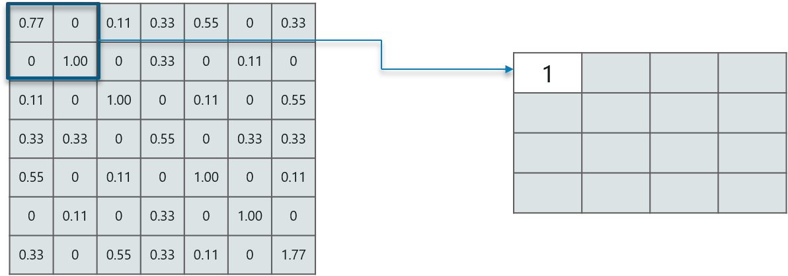
Pooling Layer – Example
Consider performing pooling with a window size of 2 and stride being 2 as well.

Slide 38
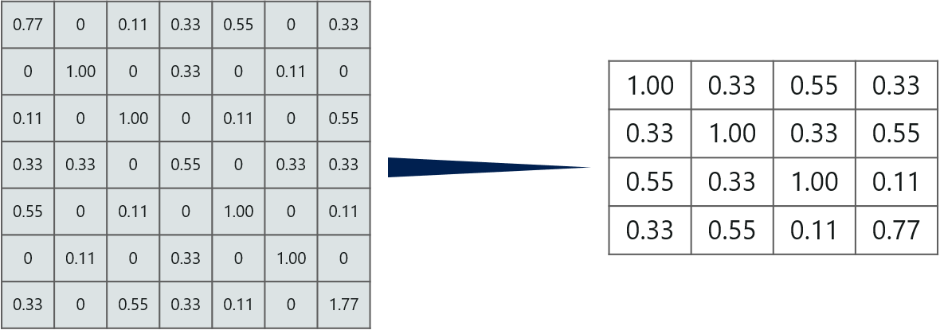
Pooling Layer – Example
But we need to move the window across the entire image

Slide 39
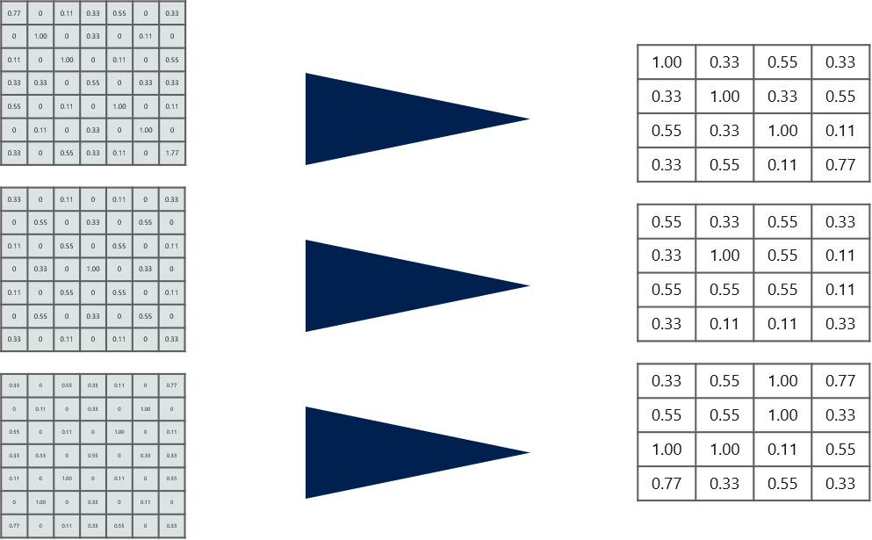
Pooling Layer – Example
Process need to repeated for all the filtered images.

Slide 40
Why pooling layer?
Feature Extraction:
By summarizing features in localized regions (e.g., through maximum or average pooling), the pooling layer captures the most important or dominant features, enhancing the network's ability to focus on key patterns.
Dimensionality Reduction:
Pooling reduces the spatial dimensions (height and width) of feature maps, which decreases the computational complexity and memory usage.
This makes the model more efficient, especially when dealing with large datasets.
Translation Invariance:
Pooling provides a degree of robustness to small shifts or distortions in the input image. For example, if an object in an image moves slightly, pooling ensures that the network still detects the object correctly.
Preventing Overfitting:
By reducing the number of parameters in the network, pooling acts as a form of regularization, helping to mitigate overfitting.

Slide 41
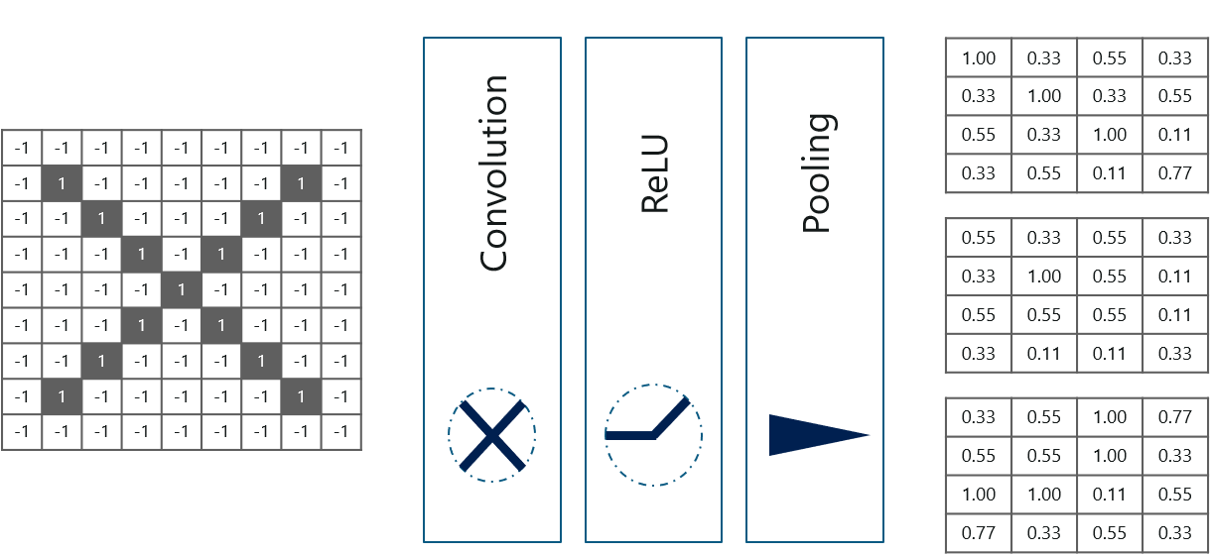
Stacking Up The Layers
So, to get the time-frame in one picture we are here with a 4×4 matrix from a 7×7 matrix after passing the input through 3 layers – Convolution, ReLU and Pooling as shown below:

Slide 42
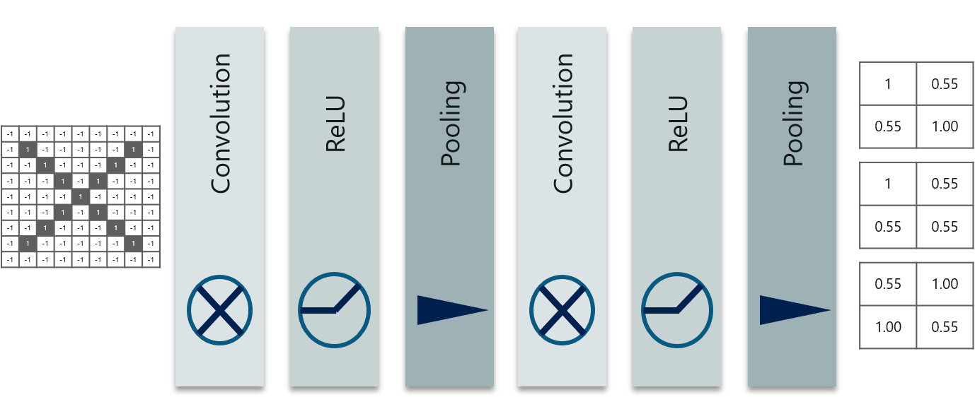
Stacking Up The Layers
Can we further reduce the image from 4×4 to something lesser?
– Yes, we can! (By repeating the previous operations once more)
After the second pass of above operations, we arrive at a 2×2 matrix as shown below:

Slide 43
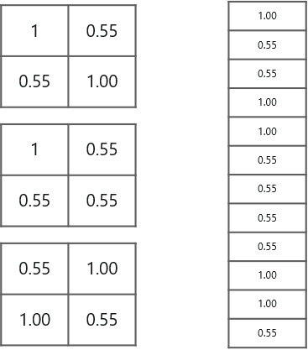
Fully connected layer
The last layers in the network are fully connected,
Means neurons of preceding layers are connected to every
neuron in subsequent layers
This mimics high level reasoning where all possible pathways from
the input to output are considered
Fully connected layer is the final layer where the classification actually happens.
Input:
filtered and shrinked images and put them into one single list as shown
Output:
Class label

Slide 44
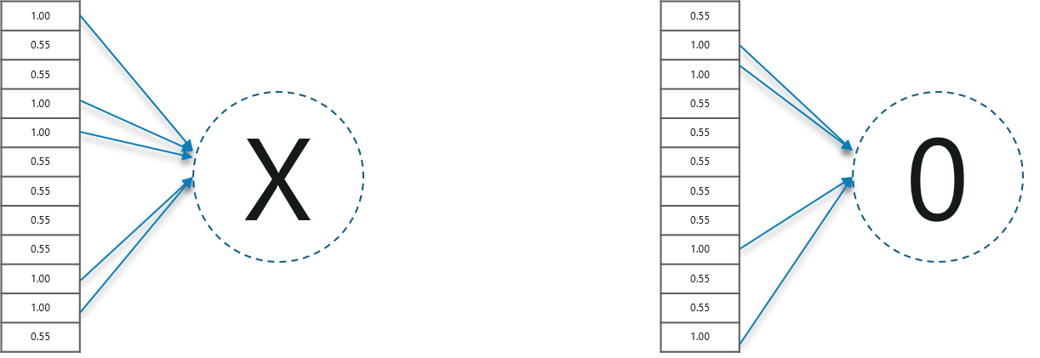
Fully connected layer – Alphabets recognition
When we feed in, ‘X’ and ‘O’ there will be some element in the vector that will be high.
In below images,
for ‘X’ there are different elements that are high and similarly,
for ‘O’ we have different elements that are high

Slide 45
Prediction using CNN – Fully Connected Layer
Now the training is done
Now, we can predict
and check the working of the classifier

Slide 46

Example
In the above image, we have a 12 element vector obtained
after passing the input of a random letter through all the layers of our network
But, how do we check what we have obtained is right or wrong?

Slide 47
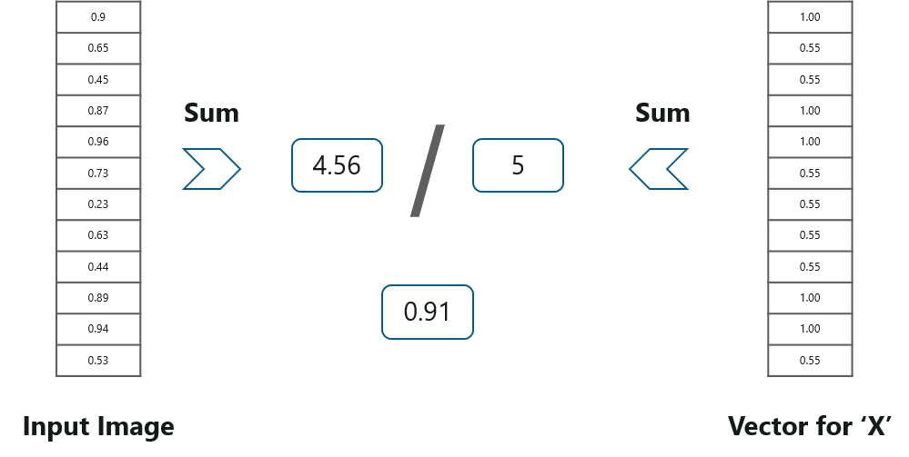
Example
We make predictions based on the output data by comparing the obtained values with list of ‘x’ and ‘o’!

Slide 48
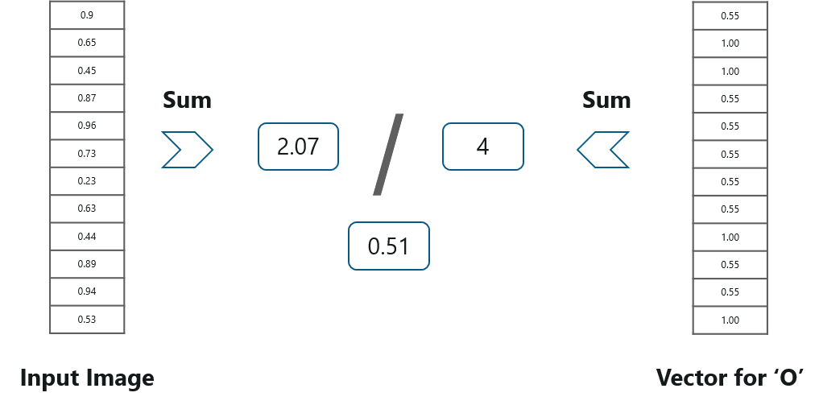
Example
Doing the same with vector table of ‘o’ now.

Slide 49
Example
We have the output probability as 0.91 with table of X.
We have the output probability as 0.51 with table of O.
Since 0.51 <= 0.91
– we can conclude that the resulting input image is an ‘x’!

Slide 50
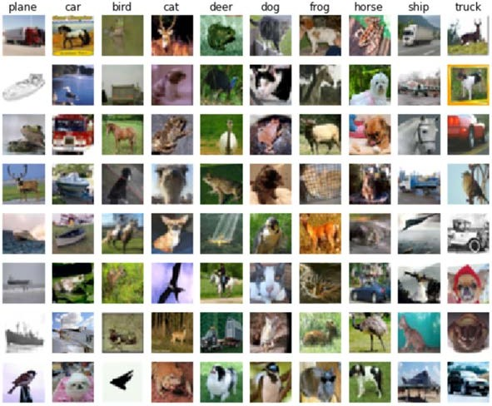
Classification of Images of CIFAR10 Dataset
Train a network to classify images from the CIFAR10 Dataset
Use of CNN built in TensorFlow.

Slide 51
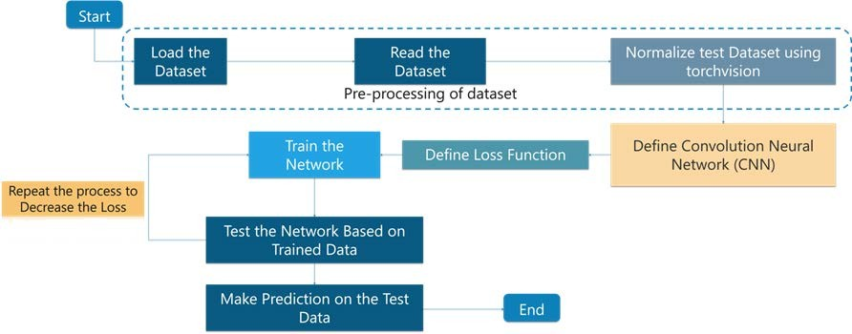
Flow diagram

Slide 52
Bibliography
TensorFlow for Deep Learning, Reza Bosagh Zadeh, Bharath Ramsundar, O'Reilly Media, Inc., ISBN: 9781491980446
Edureka: https://www.edureka.co/
TenserFlow: An end-to-end open source machine learning platform:
https://www.tensorflow.org/

